Slide 1


Presented by Ged Murphy
Notes:
Quick intro – 30s
Good morning / afternoon. My name is Ged Murphy, and I am both a student at this uni, and a developer for ReactOS.
Today I’m going to give you a brief overview of ReactOS, and highlight how working on ReactOS can assist you from both an academic perspective, and career development from a programming perspective.

Slide 2

Agenda
1. Introduction
2. NT/ROS System Design
3. ReactOS & the Win32 API
4. Roadmap
5. ReactOS & Careers
6. Summary
Notes:
All – 30s
Briefly outline the topics which will be discussed
If anyone is unclear on anything please interrupt me, but can you leave any general questions until the end.

Slide 3
Introduction
What is ReactOS?
  History
  Complete Windows replacement
  100% compatable with Windows
  Licenced under GPL
  ~20 active developers
  Freely available to everyone
Notes:
All – 300 sec
1 - What is ReactOS? – 10 sec
2 – History – 180 sec
Back in the 1970’s and 80’s, the dominant operating system was Unix. However Unix was costly, and out of the reach of your average home user.
In the early 90’s, a computer science student named Linus Torvalds, who was fascinated by hardware and operating systems started a project to rewrite the Unix kernel.
His progress was documented online and quickly aroused the interest of other developers. Development on this free version of Unix grew into what many of you know today as Linux. A dominant presence in the server market, and a potential threat to Windows in the client market.
However, this potential domination in the client market has never really taken hold as the major Linux players continually hope for. Therefore, there is still a huge niche in the market with Microsoft maintaining their stranglehold on end users, at the users cost. This is where ReactOS comes in, with an aim to do with Windows what Linux did with Unix.
ReactOS originally emerged as FreeWin95, encouraged by the growth of Linux, its goal was to write a free implementation of Windows 95. The original project didn’t get very far. There was too much talk about methodologies and not enough coding and it eventually withered away.
In 1997, one of the FreeWin95 developers put out a call out to regroup with a new goal of Windows NT, and an emphasis on writing code as opposed to emails. A new name was decided upon as a reaction to the Windows domination, and ReactOS was born.
The initial years were painfully slow. Low level coding of the kernel mode components was left to specialist developers. With no eye-candy to show to the world, the project remained relatively unknown making it difficult to attract new developers. Initial foundations for the NT kernel and HAL were put in place, and basic generic drivers were written, paving the way for the beginnings of a new operating system.
3 – Complete Windows replacement – 20 sec
ReactOS is an effort to produce a complete rewrite of the Windows NT5 operating system. Thus, ReactOS is not Linux based, but a completely new operating system.
The whole operating system is being written from the ground up, with the entire architecture simulating the NT5 architecture.
We believe most home users are so used to Windows and have become so reliant on it, that a move to a completely different operating system is simply out of the question. There is also the fact that the majority of home users simply don’t have the necessary computer skills to run Linux, or a desire to learn it.
Whilst Linux only provides a kernel with all the other components available as add-ons, ReactOS is a full operating system distribution as Windows is. This means it will not only include system architecture above the kernel, but also apps such as Explorer, Notepad and a paint package.
4 - 100% compatible with Windows – 20 sec
The aim of ReactOS is to take any Windows software off the shelf, and have it successfully install and run in ReactOS. This doesn’t just apply to software such as MS Office or Photoshop, but also applies to games and even drivers.
5 – Licensed under the GPL – 20 sec
The majority of the ReactOS codebase is licensed under the GPL. This means the full source code is available online, and freely available for anyone to download and modify at their leisure. Some parts of the source which have been incorporated from projects such as Wine or BSD are licensed according to their project.
6 – ~20 active developers – 20 sec
Our central code repository is located in Russia and is controlled via a CVS system called SVN. We have active developers from Europe, America and Canada working on ReactOS, and a strong list of contributors from all around the world.
7 – Freely available to everyone – 20 sec
Being that ReactOS is licensed under the GPL, it ensures it will always be freely available, both as in speech, and as in beer.

Slide 4
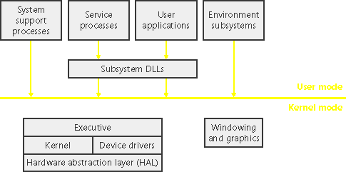
NT / ROS System Design
Notes:
All – 240 sec
Let's take a look at the key system components that make up its architecture.
A simplified version of this architecture is shown, keep in mind that this diagram is basic, it doesn't show everything. (For example, the networking components and the various types of device driver layering are not shown.)
The four basic types of user-mode processes are described as follows:
Fixed system support processes such as the logon process and the session manager, that are not Windows services. (That is, they are not started by the service control manager)
Service processes that host Windows services, such as the Task Scheduler and Spooler services. Services generally have the requirement that they run independently of user logons. Many Windows server applications, such as Microsoft SQL Server and Microsoft Exchange Server, also include components that run as services.
User applications, dealing with 32 only at present with ReactOS
Environment subsystem server processes, which implement part of the support for the operating system environment, or personality presented to the user and programmer. Windows NT originally shipped with three environment subsystems: Windows, POSIX, and OS/2. OS/2 was dropped as of Windows 2000. As of Windows XP, only the Windows subsystem is shipped in the base product—an enhanced POSIX subsystem is available as part of the free Services for Unix product.
Notice the "Subsystem DLLs" box below the "Service processes" and "User applications" boxes. Under Windows, user applications don't call the native Windows operating system services directly; rather, they go through one or more dlls. The role of the subsystem DLLs is to translate a documented function into the appropriate internal (and generally undocumented) Windows system service calls. This translation might or might not involve sending a message to the environment subsystem process that is serving the user application.
The kernel-mode components of Windows include the following:
The Windows executive contains the base operating system services, such as memory management, process and thread management, security, I/O, networking, and interprocess communication.
The Windows kernelconsists of low-level operating system functions, such as thread scheduling, interrupt and exception dispatching, and multiprocessor synchronization. It also provides a set of routines and basic objects that the rest of the executive uses to implement higher-level constructs.
Device drivers include both hardware device drivers that translate user I/O function calls into specific hardware device I/O requests as well as file system and network drivers.
The HAL is a layer of code that isolates the kernel, device drivers, and the rest of the Windows executive from platform-specific hardware differences (such as differences between motherboards).
The windowing and graphics system implements the graphical user interface (GUI) functions (better known as the Windows USER and GDI functions), such as dealing with windows, user interface controls, and drawing.

Slide 5
Component Overview
Executive
Win32 Subsystem
Networking
GDI & User Interface
DirectX & OpenGL
Notes:
All – 20 sec
Ok, I’m gonna move away from the architecture design, and speak about key components which the majority of people are interested in, and the state of these components in ReactOS.
Executive, including HAL, Kernel and device drivers
Win32 subsystem, comprising of both kernel and usermode components
The network model, from layer 2 to layer 7
GDI, windowing and the user interface
Gaming, provided by both DirectX and OpenGL.

Slide 6
Executive
HAL
  Incompatable with Windows HAL
  Minimal API’s enabling drivers to communicate as per Windows
Kernel
  Ps, Ob, Ke, IoMgr, Ex = 85% Compatible.
  Rtl= 70% Compatible.
  Se = 60% Compatible.
  Mm, FsRtl, Lpc, Cm = 40% Compatible.
  Po, Vdm= 5% Compatible.
  Cc, Wmi, Kd, Dbgk= 0% Compatible.
  AVERAGE COMPATIBILITY = 42%
Device Drivers
  Plug and Play manager
Notes:
All – 120 sec
The ReactOS HAL is incompatible with the Windows equivalent, although some work has recently been done to make it more compatible regarding calls into the kernel. It has a minimal set of APIs which drivers use to communicate with hardware which are compatible (like read/write to ports, delay execution, etc)
however, higher stuff like initialization, apic/pic support / irq handling, video init/deinit, is quite different from windows.
Discuss kernel compatability
Process Support…
Object Manager…
Kernel…
IO Manager…
Executive…
RunTime lib…
Security…
Memory Manager…
FileSystem Manager
Power Manager…
Cache Controller…
Kernel debugger + usermode debug APIs
ReactOS drivers are similar to windows versions and uses the same mechanisms (i.e. a IRP which is passed from driver to driver in the device driver stack) so we can currently support (a few) XP windows drivers (except storage stack which still uses the NT4 format)
Basics are now in place to run all XP drivers, you can install drivers with the wizard, and driver will run if it doesn't use unimplemented/buggy functions in ntoskrnl and if it doesn't use WMI as it’s not implemented yet.
The pnpmgr pretty much feature complete. It will detect the addition of new hardware and popup the install wizard, whereby you can install drivers by pointing them at the .inf file. However, it currently doesn't support the removal of a device.

Slide 7
Win32 Subsystem
CSRSS
  Console Windows
  Creating deleting process & threads
  Misc functions
Win32K
  Window manager
  GDI
ReactOS equivalents?
Notes:
All – ? Sec
The Windows subsystem consists of 2 major components, csrss which is the environment subsystem, and win32k, which is a kernel mode device driver.
Csrss.exe contains support for:
Console (text) windows
Creating and deleting processes and threads
Portions of the support for 16-bit virtual DOS machine (VDM) processes
Other miscellaneous functions, such as GetTempFile, DefineDosDevice, ExitWindowsEx, and several natural language support functions
Win32k.sys contains:
The window manager, which controls window displays; manages screen output; collects input from keyboard, mouse, and other devices; and passes user messages to applications.
The Graphics Device Interface (GDI), which is a library of functions for graphics output devices. It includes functions for line, text, and figure drawing and for graphics manipulation.
Subsystem DLLs (such as Kernel32.dll, Advapi32.dll, User32.dll, and Gdi32.dll) are the usermode dlls which translate documented Windows API functions into the appropriate and mostly undocumented kernel-mode system service calls to Ntoskrnl.exe and Win32k.sys.
our win32k and csrss are completely different from the implementation in win32k, although the architecture is rather similar
The communication between user mode and kernel mode is the same (syscalls), as well as the communication with csrss.
Everything else is different. Desktops, winstas are kernel objects as well.
We have a gdi handle table that is the same as in 2k/xp, and everything is very unstable and slow

Slide 8
Networking
ncpa.cpl – Network Control Panel
Winsock
  Usermode API’s
  winsock.dll, ws2_32.dll, mswsock.dll, etc
  ReactOS is undergoing a complete socket rewrite!
Tcpip.sys
  Tcp/ip driver, contains TCP, UDP and IP routing
  Imported TCP from BSD, wrote UDP from scratch.
  Done:- TCP, UDP and Raw Sockets, IP forwarding
  Not done:- loopback, optimizations, firewall hook?
NDIS
Working Apps?
Notes:
All – ? sec
The ReactOS network stack is a relatively recent edition. The network model follows that of the Windows model starting with Winsock as the unsemode layer applications use for network functionality.
TCP/IP and has been ported from BSD. The code was chopped and changed and finally package into tcpip.sys. Basic TCP/IP is now in place and is quite stable. Most network protocols will now transfer successfully including HTTP, FTP, IRC and SMTP/POP3. Tried and tested network applications include Firefox and Thunderbird plus many more. Varying degrees of success have been achieved with numerous server applications also, including webservers.
with NDIS at the base providing an interface to the TCP/IP driver eventually leading onto the Winsock environment for usermode applications…
NDIS is short for the "Network Driver Interface Specification". The primary purpose of NDIS is to define a standard API for "Network Interface Cards" (NIC's). The details of a NIC's hardware implementation is wrapped by a "Media Access Controller" (MAC) device driver in such a way that all NIC's for the same media (e.g., Ethernet) can be accessed using a common programming interface.
NDIS also provides a library of functions (sometimes called a "wrapper") that can be used by MAC drivers as well as higher level protocol drivers (such as TCP/IP). The wrapper functions serve to make development of both MAC and protocol drivers easier as well as to hide (to some extent) platform dependencies.

Slide 9
DirectX & OpenGL
DirectSound
  Taken from Wine
  Hacked using winmm.dll
DirectDraw
  Basics in place gdi32 <-> win32k <-> GFX driver
  Requires bugfixing
  Needs ddraw.dll implementing
DirectInput
  Keyboard, mouse, gamepad, etc
  Originally taken from Wine, but now heavily modified
  dinput.dll can/should handle all mouse and keyboard input
  Gamepads not yet implemented
OpenGL
  Full software rendering working in ReactOS
  Hardware acceleration not yet implemented
Notes:
All – ? sec
Our DirectX implementation is unusable at the moment, although it is under development.
There are many components to DirectX, but I’ll just cover the 3 people consider the most important from a gaming perspective.
DirectDraw, DirectSound and DirectInput.
Starting with DirectSound, it’s taken from the Wine project as we do not have wdmaudio support. This basically means our dsound is hacked, using winmm.dll as sound driver. It’s working well on XP and also in ReactOS
OpenGL (Open Graphics Library) is a standard specification defining a cross-language cross-platform API for writing applications that produce 3D computer graphics (and 2D computer graphics as well). The interface consists of over 250 different function calls which can be used to draw complex three-dimensional scenes from simple primitives.

Slide 10
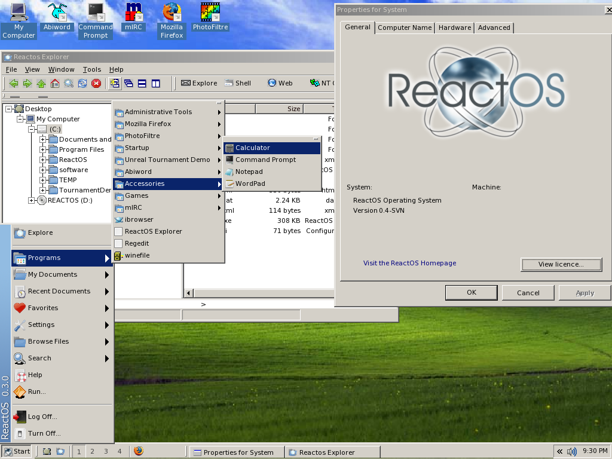
User Interface
Notes:
All – ? sec
1 – Familiarity - 90 sec
Windows users are familiar with the Windows desktop. They know what the start menu does, they know how to change the wallpaper, they know how to set up an IP address, they understand the workings of the control panel.
In order to make the switch from Windows to ReactOS as painless as possible, ReactOS provides a Windows style desktop so users immediately feel at home.
Explorer.exe arrived for the release of 0.2 and immediately pushed ReactOS into the spotlight. Up to that point Midnight Commander had been used as an interface to ReactOS, however the introduction of the GUI opened up ReactOS to a new group of developers and users alike.
Explorer is one of the few parts of ReactOS developed in C++ in order to take advantage of the OO features. Although it lacks the fancy features of XP, the taskbar, start menu, titles bars and window designs provide a familiar interface for would be users. Control panel applets are starting to take shape allowing configuration of the desktop in the same manner as Windows. Additional quirks include a task manager and NT service manager with many more in development.

Slide 11
ReactOS & the Win32 API
Entire Win32 API available
Usermode dll’s
Wine project
Notes:
All – ? sec
The majority of the Win32 API is shared with Wine. ReactOS took advantage of the progress Wine has made in it’s 10 years of development, importing many of their dlls giving an immediate boost to their application compatibility…

Slide 12
Roadmap
LSASS (local security authority server)
Win32K rewrite
70% kernel compatability by end ’07
DirectX
NTFS support?
Build ReactOS using MSVC
Notes:
All – ? sec

Slide 13
Reactos & Careers
Programming, C / C++ experience
Deep insight into Windows development
Advantage when taking degree courses
More employable?
ReactOS as a potential income?
Notes:
All – ? sec

Slide 14
Summary
100% Windows compatible replacement
NT system architecture
ReactOS equivalent and their status
Roadmap
Education and Careers
Notes:
All – 60s
1 100% Windows compatible replacement – 10s
…

Slide 15
Demonstration!
Questions?
Notes:
Question time!
A demonstration of ReactOS!

